Slide 1

Content-Based Retrieval (CBR)
-in multimedia systems

Slide 2
Outline
Content-Based Retrieval (CBR)
Content-Based Image Retrieval (CBIR)
Content-Based Video Retrieval (CBVR)
Content-Based Audio Retrieval (CBAR)

Slide 3
What is Content-Based Retrieval (CBR) ?
Content-Based Retrieval (CBR)
  Digital Library
  Contents contained in digital text, sound, music, image, video, etc
  Serve as a browsing tool
  Keyword indexing is fast and easy to implement. However, it has limitations.
    Can’t handle nonspecific query, “Find scenic photo of Uvic”
    Misspelling is frequent and difficult, “azalia” for “azalea”
    Descriptions are often inaccurate and incomplete

Slide 4
Content-Based Image Retrieval (CBIR)
How can images be described automatically so that they can be compared efficiently and effectively, and in a way that can be considered useful from a user perspective?
… and a possible solution
A quantitative definition of effectiveness, and a complete statistical analysis of the image descriptors and of their possible comparison strategies.

Slide 5
Retrieval by Similarities
- Color Similarity
Color Similarity:
Color distribution similarity has been one of the first choices because if one chooses a proper representation and measure it can be partially reliable even in presence of changes in lighting, view angle, and scale.
RED
YELLOW
YELLOW
BLUE
BLUE
RED
Notes:
In Image 1, the top left quarter (25%) is red, the bottom left quarter (25%) is blue, and the right half (50%) is yellow. In Image 2, the top right quarter (25%) is blue, the bottom right quarter (25%) is red, and the left half (50%) is yellow.
So the 2 images have complete similarity (score = 0.0), because each color (red, blue, yellow) occupies the same percentage of the total image in each one.

Slide 6
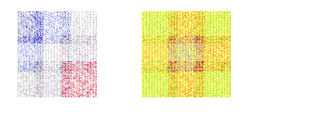
Retrieval by Similarities
- Texture Similarity
Texture Similarity:
Texture reflects the texture of entire image.
Texture is most useful for full images of textures, such as catalogs of wood grains, marble, sand, or stones.
Texture images are generally hard to categorize using keywords alone because our vocabulary for textures is limited
Wold Decomposition
  Periodic
  Evanescent
  Random

Slide 7

Retrieval by Similarities
- Shape Similarity
Shape Similarity:
Shape represents the shapes that appear in the image.
Shapes are determined by identifying regions of uniform color.
Shape is useful to capture objects.
Shape is very useful for querying on simple shapes.

Slide 8
Retrieval by Similarities
- Spatial Similarity (1)
Spatial Similarity:
  Symbolic Image
  Spatial similarity assumes that images have been segmented into meaningful objects, each object being associated with is centroid and a symbolic name. This representation is called a symbolic image.
  Similarity Function
  It is relatively easy to define similarity functions for such image modulo transformations such as rotation, scaling and translation.

Slide 9
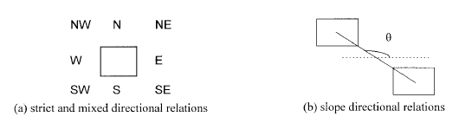
Retrieval by Similarities
- Spatial Similarity (2)
Directional Relations

Slide 10
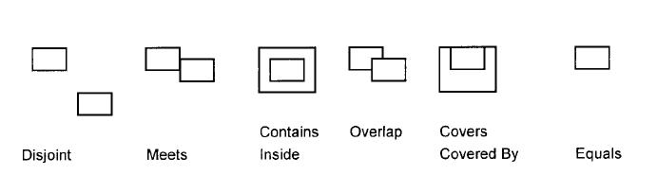
Retrieval by Similarities
- Spatial Similarity (3)
Topological Relationship

Slide 11
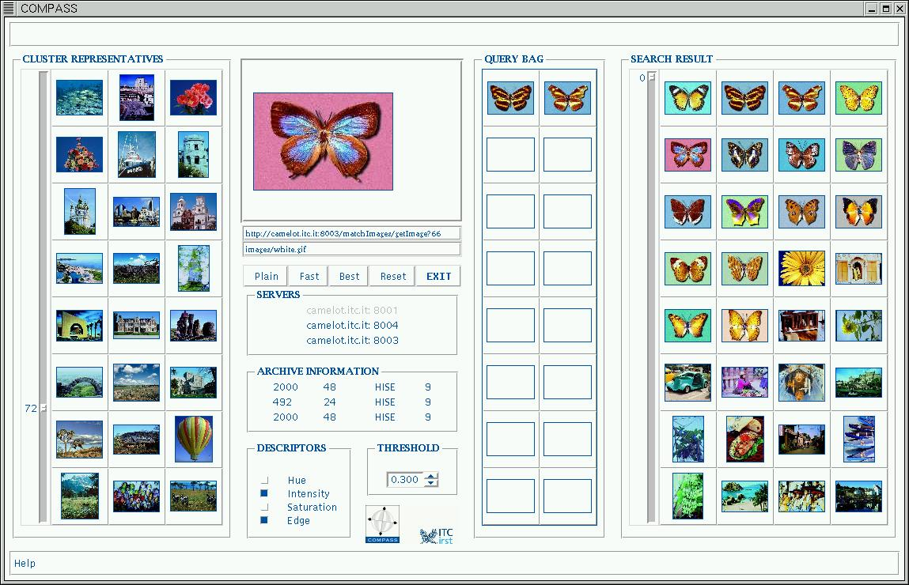
COMPASS

Slide 12
Content-Based Video Retrieval(1) (CBVR)
Spatial Scene Analysis
Color Feature Space
Color is an important cue for measuring the similarity between visual documents.
Texture Feature Space
The analysis of textures requires the definition for a local neighborhood corresponding to the basic texture pattern.
Supervised Feature Space
More complex features may be defined for parsing the contents of a video document. i.e Face Detection, Text Annotation.

Slide 13
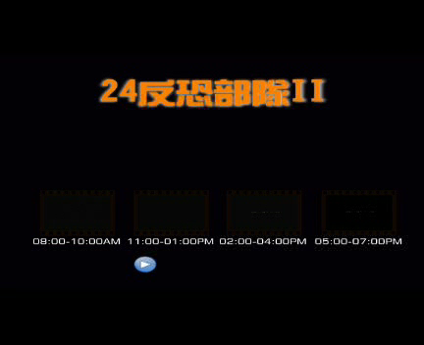
Content-Based Video Retrieval(2) (CBVR)
Temporal Analysis
Levels of Granularity:
  Frame-Level
  Short-Level
  Scene-Level
  Video-Level
Types of Shot-Level:
  Cut
  Dissolve
  Wipe
Notes:
Spatial Scene Analysis on video can be fully transferred from CBIR. But Temporal analysis is the uniqueness about video. Temporal Information induces the concept of motion for the objects present in the document.
The temporal analysis of that document typically requires its partitioning into basic elements recognized at four different levels of granularity:
Frame level: Each frame is treated separately. There is no temporal analysis at this level.
Shot-level: A shot is a set of contiguous frames all acquired through a continuous camera recording. Only the temporal information is used.
Scene-level: A scene is a set of contiguous shots having a common semantic significance.
Video-level: The complete video object is treated as a whole.
From which Shot-Level is the most concerned basic element, three types:
Cut: A sharp boundary between shots. This generally implies a peak in the difference between color or motion histograms corresponding to the two frames surrounding the cut.
Dissolve: The content of last images of the first shots is continuously mixed with that of the first images of the second shot.
Wipe: The images of the second shot continuously cover or push out of the display that of the first shot.

Slide 14
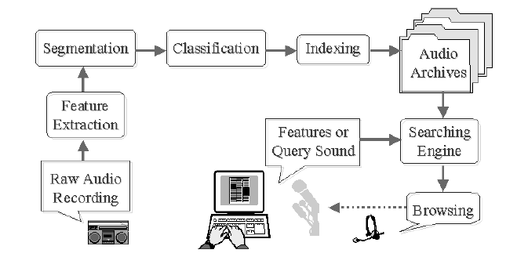
Content-Based Audio Retrieval (CBAR)

